Slide 1
Microbial Intelligence
Dileep Kishore

Slide 2
The Motivation
Microorganisms play an important role in everything from human health to biogeochemical cycles
To put it simply, microbes run the world
They usually occur in complex communities
The community interaction is so important for the microbes that it has been found that most microbes can't be grown independently in the lab

Slide 3
What is intelligence?
Is it IQ? Is it the presence of a brain?
Are micro-organisms intelligent?
Acquiring information, storage, processing, use of information, perception, learning, memory, and decision-making
Parallels exist not only at the heuristic level of functional analogues, but also at the level of molecular mechanisms
From complex adaptive behavior shown by single cells to the cooperative behavior in populations of like or unlike cells

Slide 4
The idea
The various levels of control in a microbial cell can be broadly separated into two layers
Regulatory layer: A network of proteins and RNA that regulate the genes
Metabolic layer: A complex network of interconversion of metabolites
A new modeling framework
A neural network as the regulatory layer utilizing reinforcement learning as a proxy for learning through adaptation to the environment
A constraint-based linear programming model as the metabolic layer

Slide 5
Questions to address
Would this framework help us model the adaptation of a single bacterial cell to dynamic changes in its environment?
Would a community of these microbes modeled using this framework learn to exhibit the same properties as natural microbial communities?
Would the underlying structure and weight distribution of the neural network give us any insight into the structure of the regulatory network inside a cell?

Slide 6
The Model

Slide 7
Modeling Framework
Reinforcement Learning
Linear Optimization
Components

Slide 8
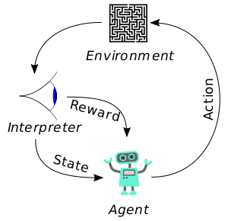
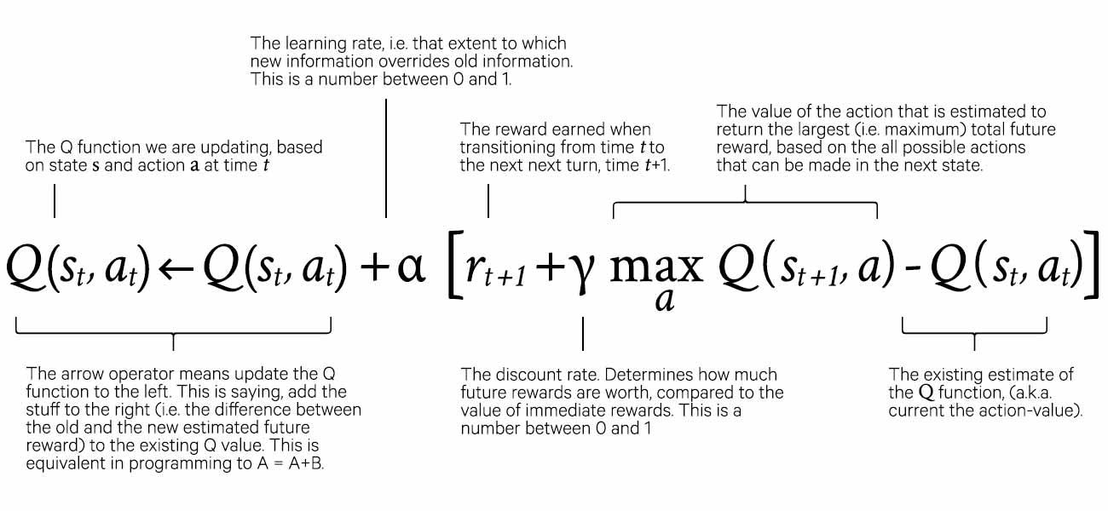
Reinforcement Learning
How does an agent undertake actions in an environment so as to maximize cumulative reward?
Exploration vs. Exploitation
https://www.datahubbs.com/reinforcement-learning/
http://www.cs.princeton.edu/~andyz/pacmanRL

Slide 9
Reinforcement Learning - Tools
RL algorithms
Deep Q Learning (DQN) [1], [2]
Double DQN [3]
Deep Deterministic Policy Gradient (DDPG) [4]
Continuous DQN (CDQN or NAF) [6]
Cross-Entropy Method (CEM) [7], [8]
Dueling network DQN (Dueling DQN) [9]
Deep SARSA [10]
ML frameworks
Keras
Pytorch
Model testing framework
OpenAI gym

Slide 10
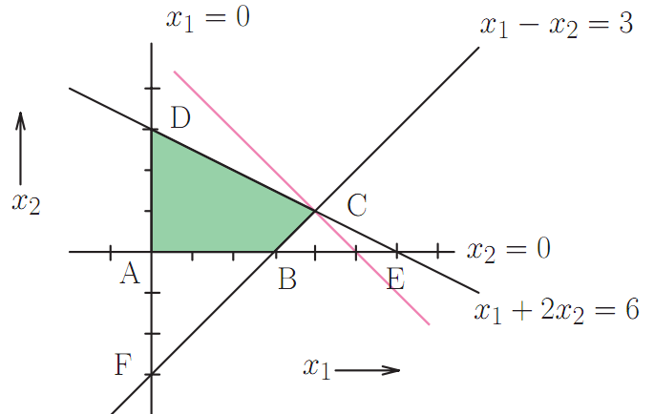
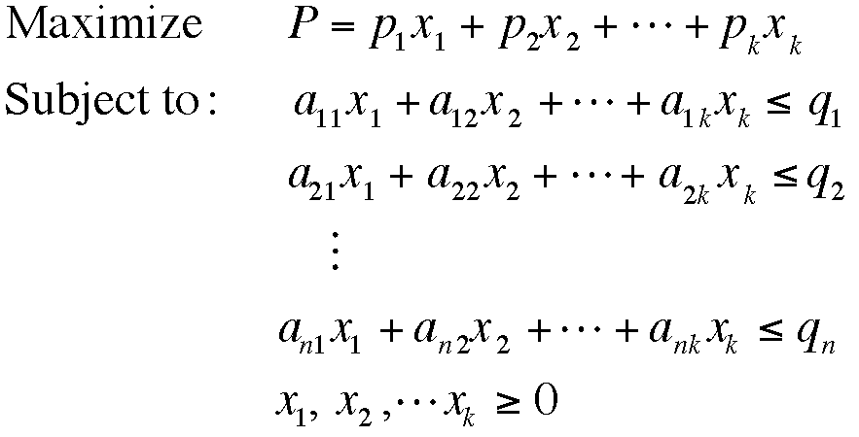
Linear Optimization
Technique for the optimization of a linear objective function, subject to linear equality and linear inequality constraints
http://www.statslab.cam.ac.uk/~rrw1/opt/

Slide 11
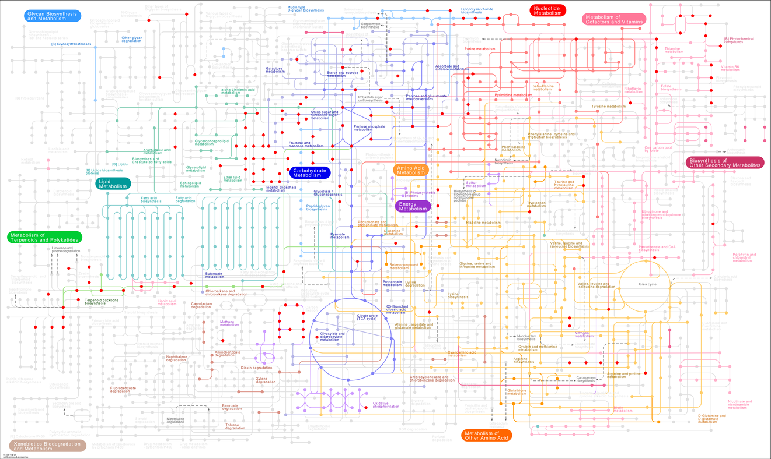
Metabolism and FBA
Based on steady-state material balance
Genome scale metabolic models:
Variables are reaction fluxes
Constraints are mass balance conditions
Objective is usually to maximize biomass production
Flux Balance Analysis (FBA)
Method to simulate genome scale metabolic models
Uses Linear Optimization

Slide 12
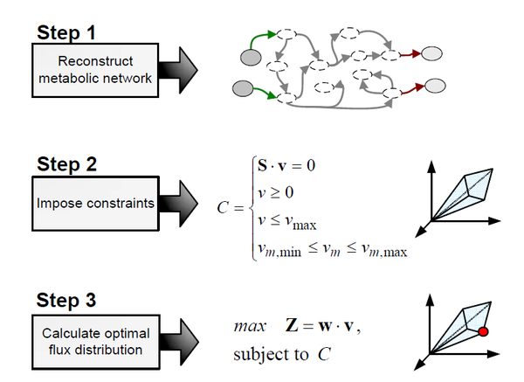
Linear Optimization - Tools
Algorithms
Flux Balance Analysis (FBA)
FBA frameworks
Cobrapy
Optimization frameworks
CPLEX
Gurobi
http://2014.igem.org/Team:Valencia_UPV/Collaboration

Slide 13
The Big Picture

Slide 14
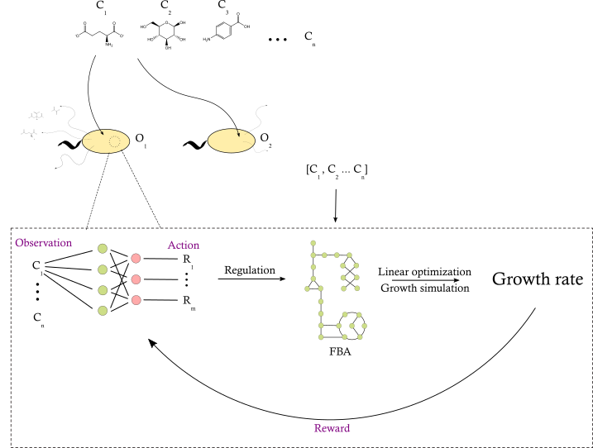
The environment
External Metabolites
The agent
Microorganisms
Metabolic Network
Neural Network

Slide 15
Inputs
Outputs
Concentrations of metabolites at each step
A vector of contiguous values with size equal to the number of possible metabolites that can exist in the environment
The result of the FBA algorithm
Growth rate (biomass production rate)
This value is the reward
The agent performs actions in order to maximize this reward

Slide 16
Recap
A new modeling framework that utilizes a neural network as the regulatory layer and reinforcement learning as a proxy for learning through adaptation to the environment
This layer controls the usual constraint based metabolic network model
The framework might help us understand the adaptation of microorganisms to dynamic environments

Slide 17

Thank you
https://github.com/dileep-kishore/microbial-ai

